Slide 1

Critical PATH REASONING: on Certainty, inference, and comprehension
Cole Prather – w/ reference to The Ethical Skeptic

Slide 2
Outline
Observation
The Riddle of Certainty
Doubt and Skepticism
Confirmation Bias
Modes of Logic
Map of Inference
Pseudoscience and Methodical De-escalation
Science vs “Sciebam”
The Scientific Method
Critical Path vs Critical Thinking
Comprehension vs Understanding
Takeaways and Questions

Slide 3
Abstract
Critical thinking is a term widely used in academics yet is a weak form of logical inference akin to abduction, and especially weak as compared to induction or a stronger form of inference - deduction. By establishing a framework which prioritizes questions over answers and function over form, and by investigating modes of inferential logic, reexamining the scientific method, and distinguishing between comprehension and understanding, a deductive "critical path" of logical inference is prescribed to effectively prosecute hypotheses and disrupt paradigm.

Slide 4
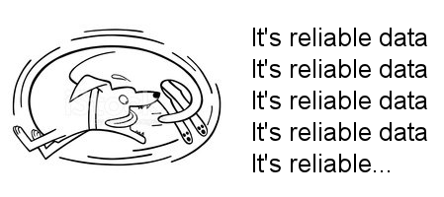

Slide 5
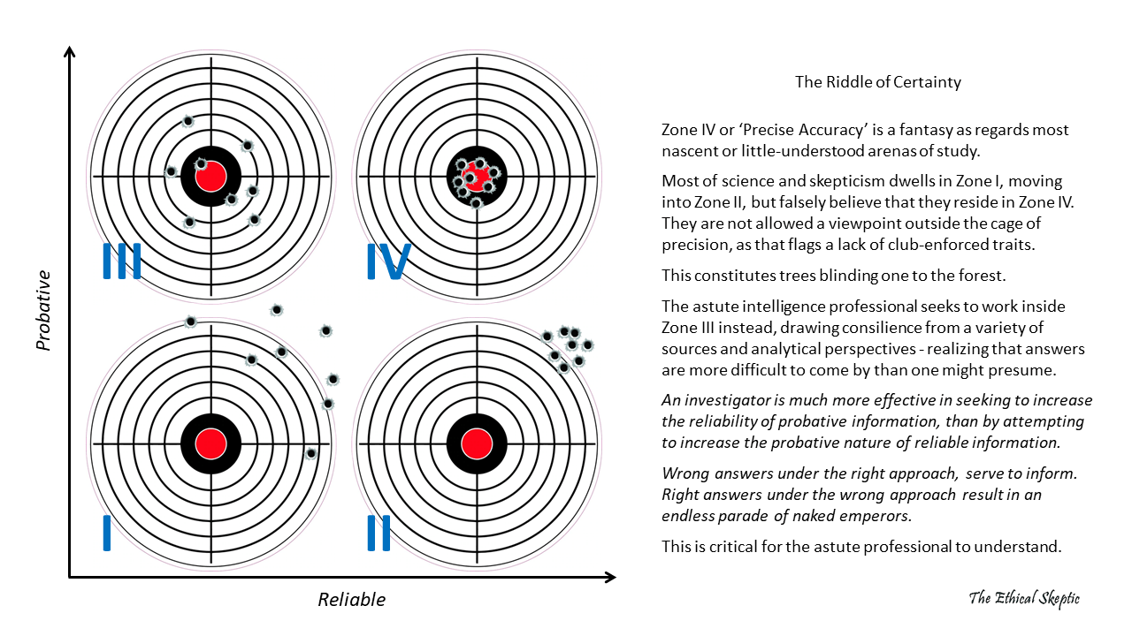
https://theethicalskeptic.com/2021/12/24/the-riddle-of-certainty/

Slide 6
The Riddle of Certainty
“An investigator is much more effective in seeking to increase the reliability of probative information, than by attempting to increase the probative nature of reliable information.”
Increasing precision of accurate information > Increasing accuracy of precise information
“Fewer and more spread detections are more valuable than deep but concentrated ones. Information should be rated on its reach and not simply its confidence.”
“Wrong answers under the right approach, serve to inform. Right answers under the wrong approach result in an endless parade of paradox and naked emperors.”

Slide 7
Doubt and Skepticism
“Religion is a culture of faith. Science is a culture of doubt.” – Richard Feynman
Methodical Doubt – doubt employed as a skulptur mechanism, to slice away disliked observations until one is left with the data set they favored before coming to an argument. The first is the questionable method of denying that something exists or is true simply because it defies a certain a priori stacked provisional knowledge. This is nothing but a belief expressed in the negative, packaged in such a fashion as to exploit the knowledge that claims to denial are afforded immediate acceptance over claims to the affirmative. This is a religious game of manipulating the process of knowledge development into a whipsaw effect supporting a given conclusion set.
Deontological Doubt (epoché) – if however, one defines ‘doubt’ as the refusal to assign an answer (no matter how probable) for a specific question – in absence of assessing question sequence, risk and dependency (reduction), preferring instead the value of leaving the question unanswered (null) over a state of being ‘sorta answered inside a mutually reinforcing set of sorta answereds’ (provisional knowledge) – then this is the superior nature of deontological ethics.
Epoché – or the suspension of disposition, is the discipline of ethical skepticism which disarms such sleight-of-hand abuse by means of abductive rationalization.

Slide 8
Doubt and Skepticism
Most fake skeptics define ‘doubt’ as the former and not the latter – and often fail to understand the difference.
It is this very habit of seeking expedient force-to-simple understanding, in lieu of rigorous comprehension, which renders one vulnerable to the corrupted philosophy of abductive reasoning.
Abduction is a false notion, a square peg of philosophy we keep trying to hammer into the round hole of science. Because it affords us comfort in avoiding the painful ‘blue balls’ of skepticism or dissonance.
A simple wrong answer is much worse than a complicated one, because the former is harder to dispel. (Cultivated Ignorance)
"It is the mark of an educated mind to rest satisfied with the degree of precision which the nature of the subject admits and not to seek exactness where only an approximation is possible." - Aristotle (Nichomachean Ethics)

Slide 9
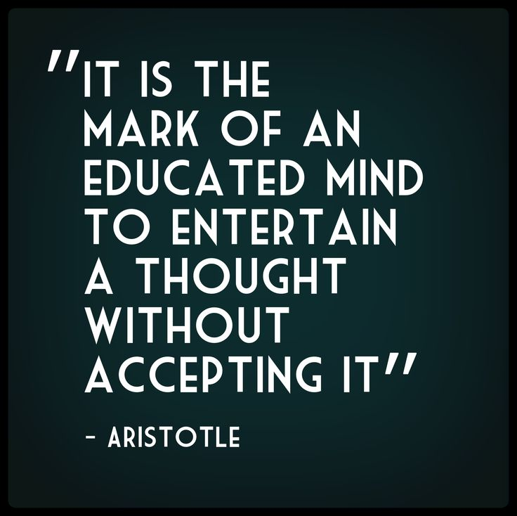
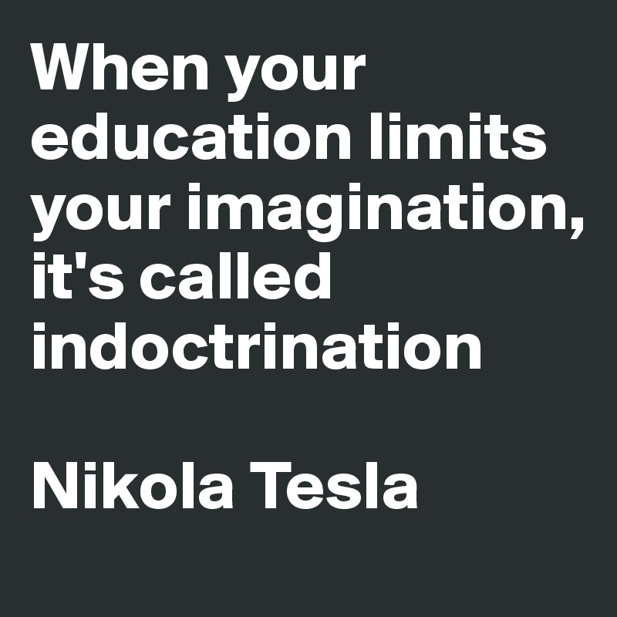
Doubt and Skepticism
"It is the mark of an educated mind to rest satisfied with the degree of precision which the nature of the subject admits and not to seek exactness where only an approximation is possible." - Aristotle (Nichomachean Ethics)
“New ideas must be shaped with vision and imagination, not just inherited knowledge. Too much education without independent thought leads to indoctrination, not intelligence.” – Nikola Tesla
https://news.ycombinator.com/item?id=5495896

Slide 10
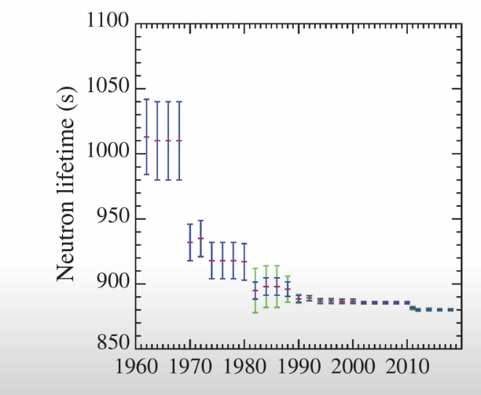
Confirmation Bias
“Scientists have systematically underestimated the uncertainty of their measurement.” – Sabine Hossenfelder
https://www.youtube.com/watch?v=uEZ9HFlqzms
Particle Data Group

Slide 11
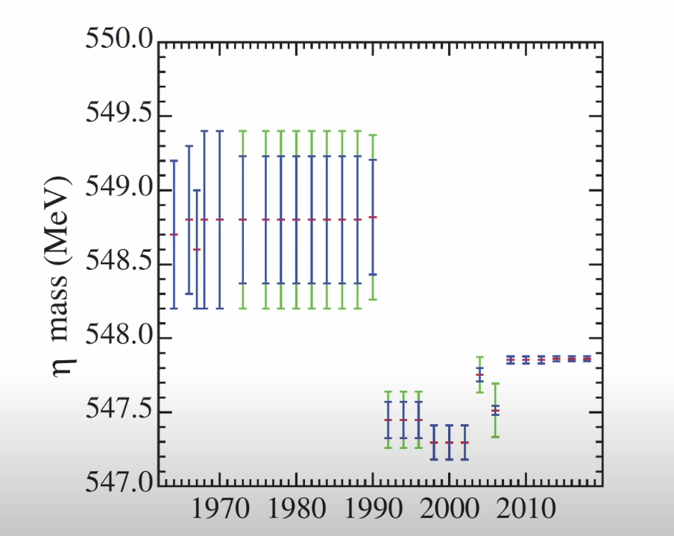
Confirmation Bias
“Scientists have systematically underestimated the uncertainty of their measurement.” – Sabine Hossenfelder
https://www.youtube.com/watch?v=uEZ9HFlqzms
Particle Data Group

Slide 12
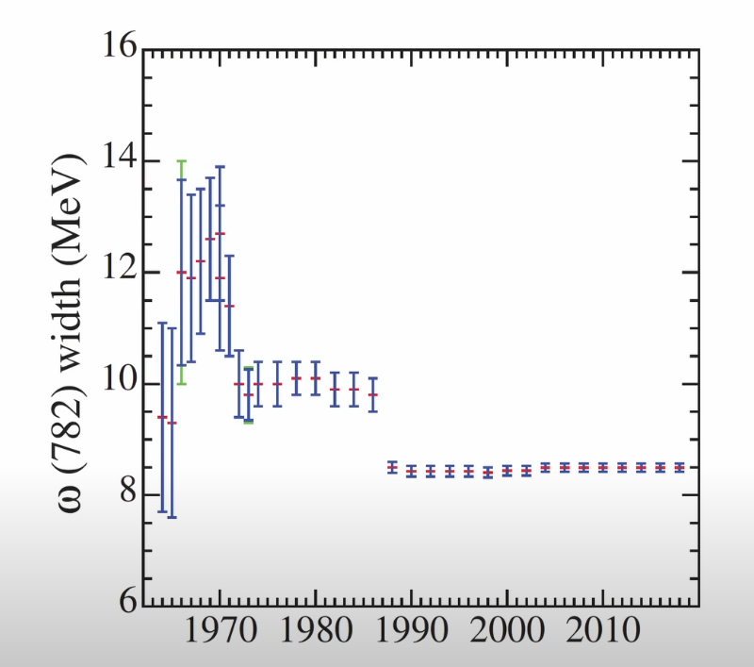
Confirmation Bias
“Scientists have systematically underestimated the uncertainty of their measurement.” – Sabine Hossenfelder
https://www.youtube.com/watch?v=uEZ9HFlqzms
Particle Data Group

Slide 13
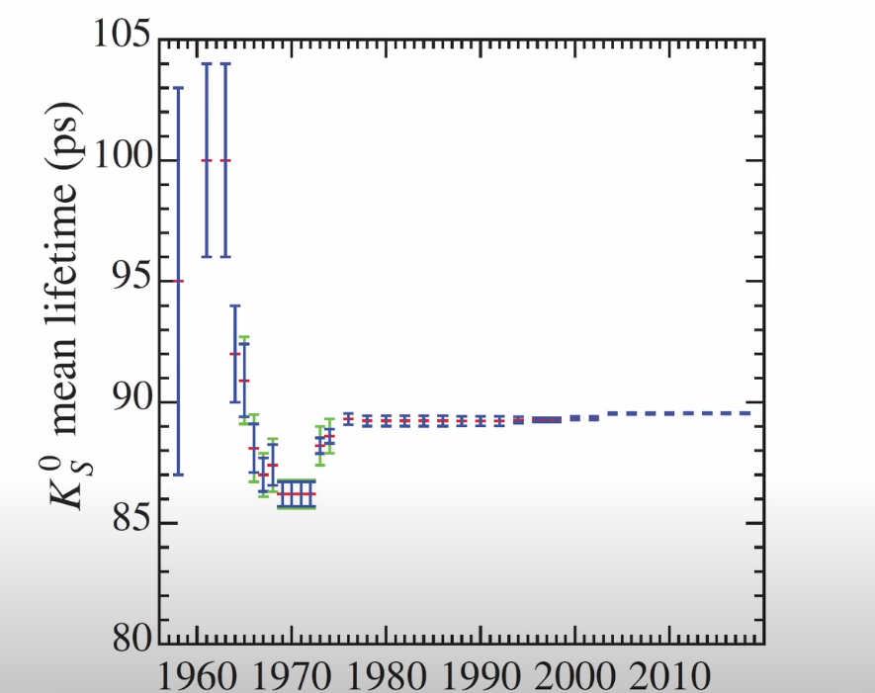
Confirmation Bias
“Scientists have systematically underestimated the uncertainty of their measurement.” – Sabine Hossenfelder
https://www.youtube.com/watch?v=uEZ9HFlqzms
Particle Data Group

Slide 14
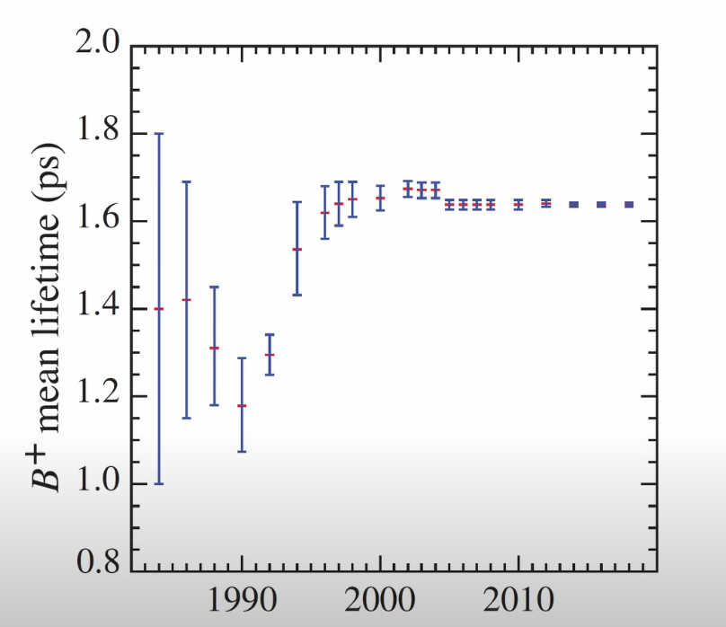
Confirmation Bias
“Scientists have systematically underestimated the uncertainty of their measurement.” – Sabine Hossenfelder
https://www.youtube.com/watch?v=uEZ9HFlqzms
Particle Data Group

Slide 15
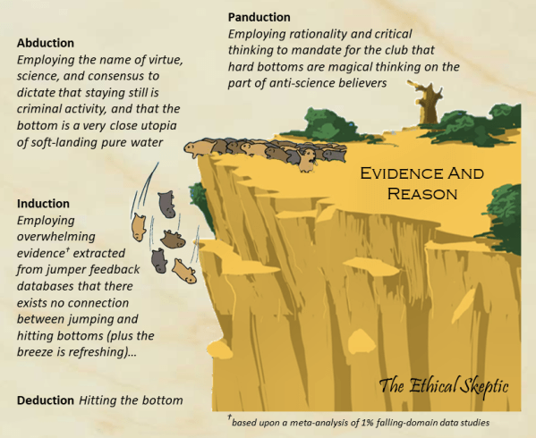
Modes of Logic
Inference – turning observational premises into conjecture (hopefully beneficial, and usually bears some risk)
Panduction
Abduction
Induction
Deduction
Scientific Logic Reduction
The Scientific Method
Mathematical Reduction

Slide 16
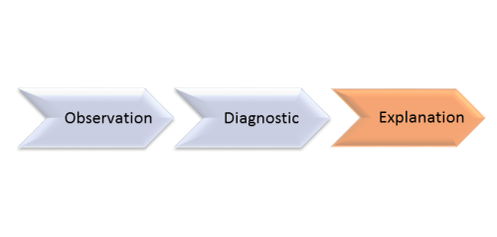
Abductive Reason

Slide 17
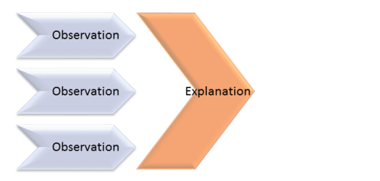
Inductive Reason

Slide 18
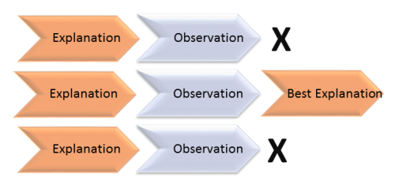
Deductive Reason

Slide 19
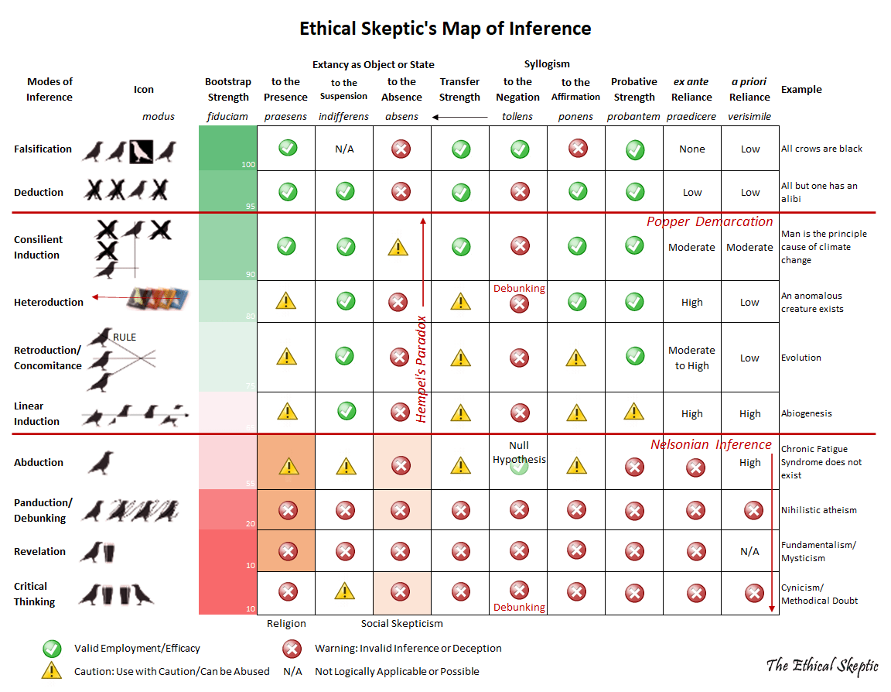

Slide 20
Pseudoscience and Methodical De-escalation
Deduction > Induction > Abduction > Panduction
“... when induction is used in lieu of deduction or abduction is used in lieu of induction, when the higher order of logical inference could have been used – beware that pseudoscience might be at play.”
“Choosing the lower order of logical inference can be a method by which one avoids challenging alternatives and data yet still tenders the appearance of conducting science.”
“One can dress up in an abductive robe and tender all affectation of science; utter all the right code phrases and one-liners about ‘bunk’ – but an ethical skeptic is armed to see through such a masquerade.”

Slide 21
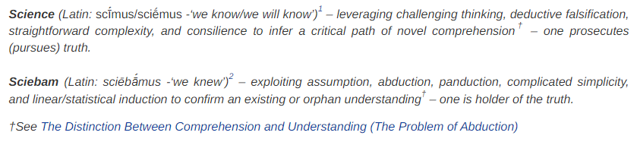
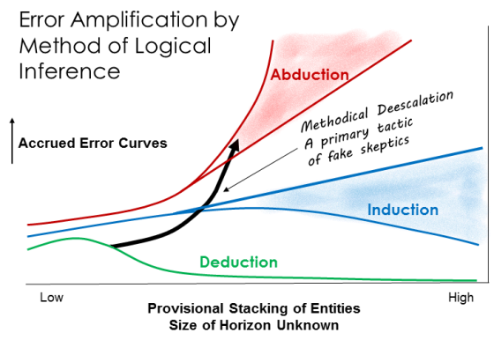
Science vs “Sciebam”
“Believe those who are seeking the truth; doubt those who find it.” – Andre Gide
Science: “I learn or come to know” - to infer a novel path of comprehension.
Deduction: Conclusiveness – Benefit from falsified ideas is stacked (Understanding Evolves)
Induction: Likeliness – Iterations or predictive trials are stacked (Understanding Matures)
“Sciebam”: “I knew” - to enforce an existing interpretation.
Abduction: Correctness – Assumptions are stacked (Understanding Codifies)
Panduction: Doctrine – Everything but what my club believes, is correlated and falsified (Understanding Decays – an invalid form of inference)
https://theethicalskeptic.com/2022/02/17/sciebam-religion-with-p-values/

Slide 22
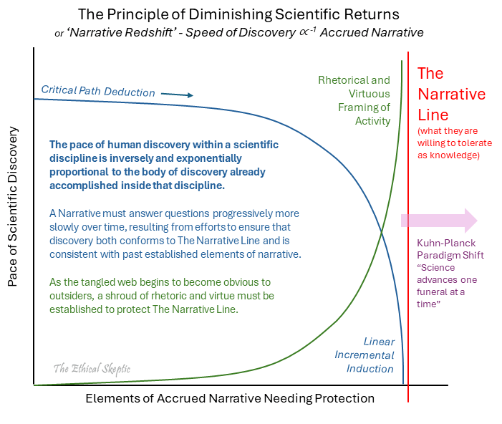
The Narrative Redshift or Principle of Diminishing Scientific Returns – as the lies increase, in an effort to protect The Narrative, the pace of scientific discovery decreases exponentially as a result—while the pace of rhetoric and virtue-shielding must increase non-linearly as an outside audience begins to perceive the oncoming shortfall in ethics and value. This is a form of syndicate hand-waving.

Slide 23
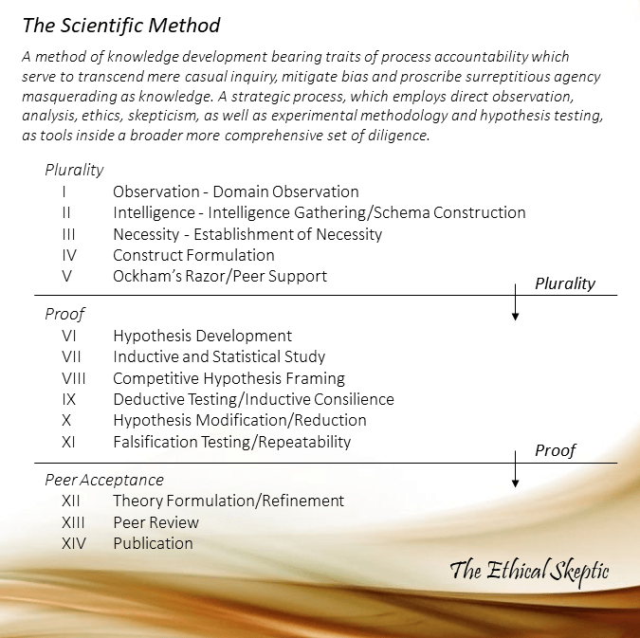
The (Real) Scientific Method

Slide 24
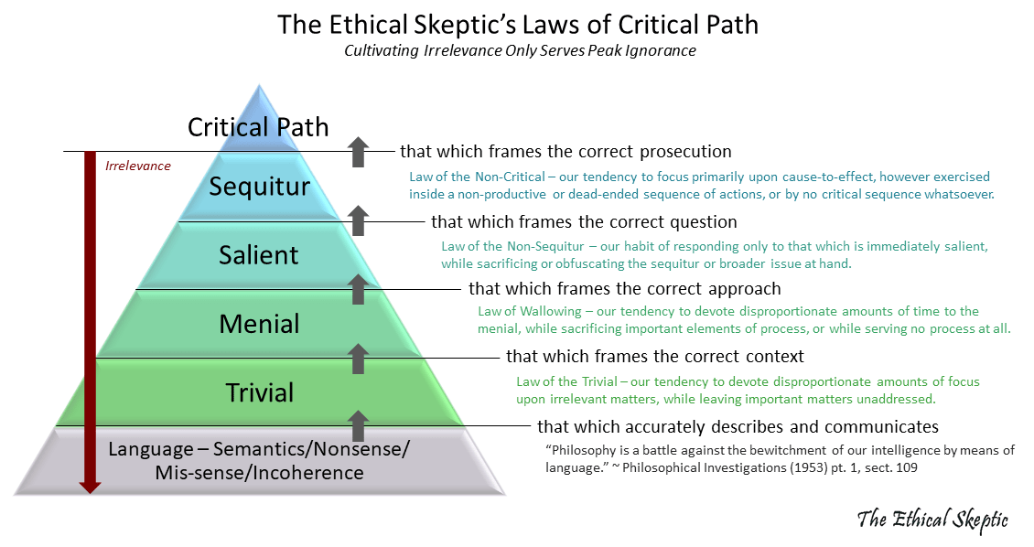
The Ethical Skeptic’s Critical Path
https://theethicalskeptic.com/2022/01/27/the-strategic-mindset/

Slide 25
What is a Critical Path?
“A critical path is the ordered chain of incremental events or logic which produces the most elegant pathway to a reasonably constrained objective.”
“The process of science involves a carefully planned set of steps, which allows us to bridge this gap between premise and robust conjecture by means of the most clear, value laden, and risk abating pathway which we can determine.”
It is driving down a dark road at night with no known destination
Science
Logic
Systems

Slide 26
What about Critical Thinking?
Critical thinking in popular culture is “more about explaining the reasons why what is right is right.” (Sciebam)
Critical path logic in science is “about applying intelligence to discover the pathway to what is right.” (Science)
“I did not know. I went and looked. Everything else was vanity.” - TES

Slide 27
Examples of Critical Path Logic
Science
“the critical/sound basis from which to ask each next incremental question under the scientific method, which will serve to most completely and confidently answer a single query into the unknown.”
Operations Research
“the critical sequence of task and work content analytics which serve to attain a specific goal in the most objective/constraint effective method.”

Slide 28
Examples of Critical Path Logic
Legal Prosecution
“the critical sequence of evidences and questions which serve to convict or acquit a defendant.”
Patent Prosecution
“the critical set of disclosures, prior art, framings, constraints and claims, which inexorably lead to a non-obvious, teachable and novel invention, use or application.”
Target Prosecution
“in the Navy, when hunting a sub, the sub’s position is unknown at first. However, it can be eventually derived through a deductive process of critical path called Target Motion Analysis. This is a logical and incremental series of questions which, once answered, reveal a set of, or even one single possible instance of, a sub’s location, depth, speed and heading.”

Slide 29
Phases of Inference
Develop a mathematical pathway of logical reduction which evolves flexibly by novel outcomes rather than deterministically (as does maths),
Constrain to iteratively and convergently test critical pairs of modus ponens conjecture (the novelty), and
Sequence testing in such a fashion as to maximize probative potential and either an intelligence structure or unifinality (reduce entropy of knowledge, not monofinality).

Slide 30
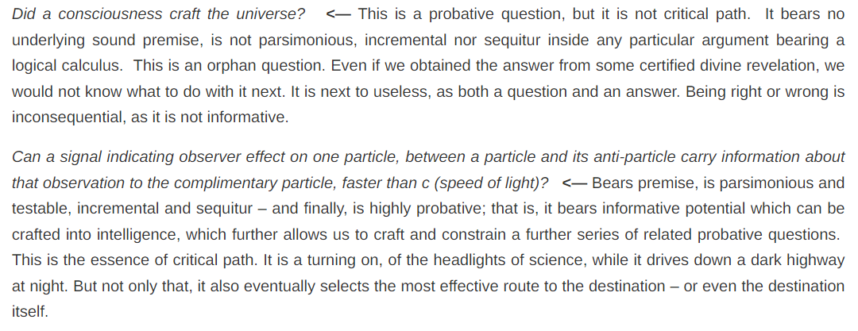
Consider the following questions:
“Religion is a culture of faith. Science is a culture of doubt.” – Richard Feynman

Slide 31
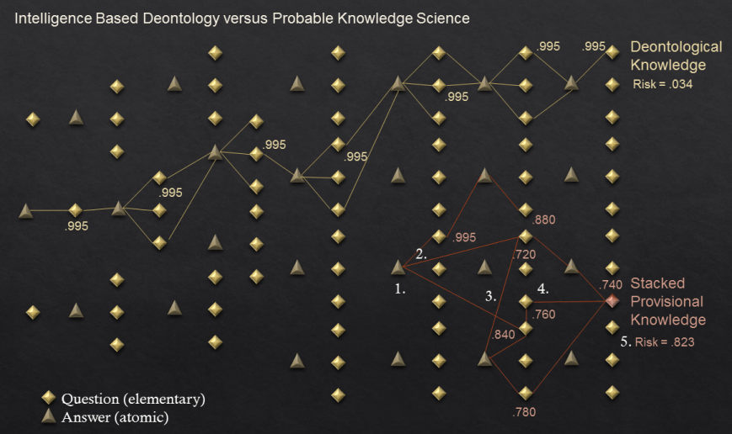
Questions are More Important than Answers
“A deontologist prefers a state of ‘unknown’ over even a highly probable stacked set of provisional knowledge, because of the preferential deontological ethics of declaring a precise answer to be unknown, over ‘probably known’ inside a context of low intelligence and unevaluated risk.”
“Data is a set of answers without context of question. Intelligence is a framework of questions which have either certain or null answers. The latter is more informative than the former.”
https://theethicalskeptic.com/2016/09/10/risk-of-stacked-most-probable-knowledge-versus-query-oriented-deontology/

Slide 32
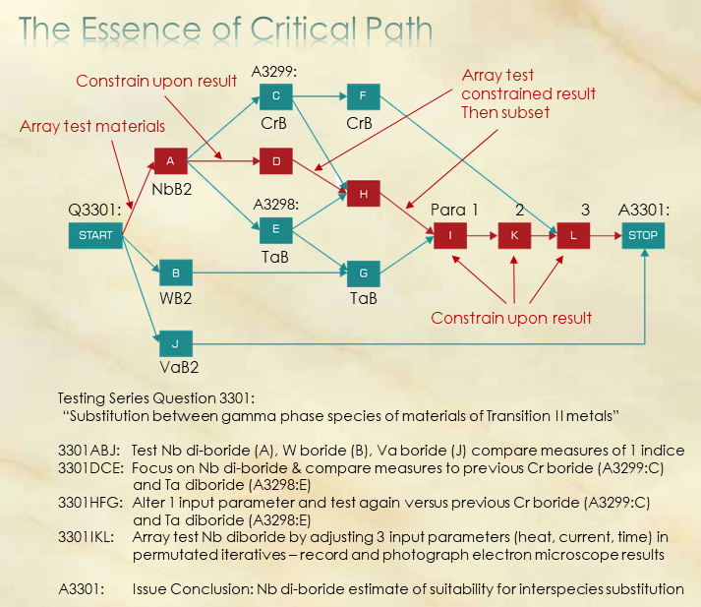
“Comparing the compatibility of various transition metals as to their lattice substitution tolerance”
https://theethicalskeptic.com/2018/03/25/the-role-of-critical-path-in-logic-systems-and-science/

Slide 33
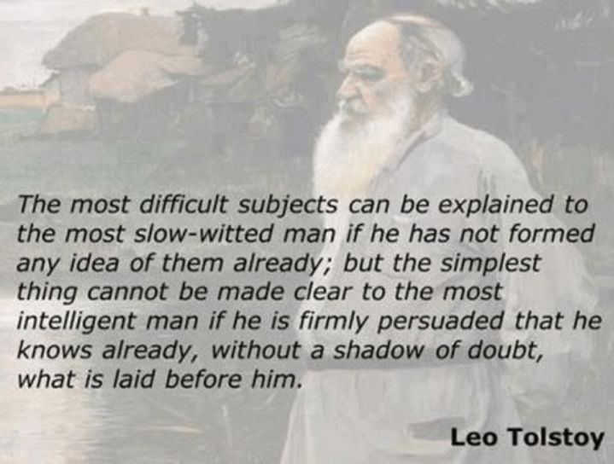
Comprehension vs Understanding
“Comprehension is meta-understanding, which innately disrupts paradigm even more effectively than it does ignorance.
It is not simplicity, but rather the reduction of complicatedness, which is indeed the true scientific virtue.” – TES
“It is impossible for a man to learn what he thinks he already knows.” - Epictetus
“The one thing I know is that I know nothing.” - Socrates

Slide 34
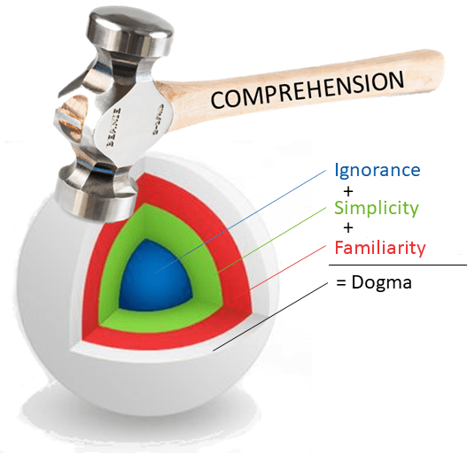
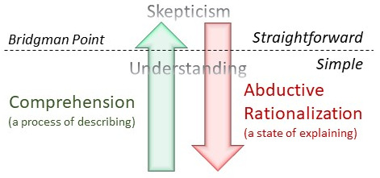
Comprehension vs Understanding
Abduction is a Wittgenstein state of explaining and should never be conflated with the descriptive process of logical derivation and inference.
“Everything should be made as simple as possible, but not simpler.”
- Albert Einstein
“Only describe, don’t explain.”
- Ludwig Wittgenstein, Tractatus Logico-Philosophicus

Slide 35
Takeaways
“Under this philosophy of ‘function over form’, always therefore prefer
elegance over beauty
the straightforward over the simple
the complex over the complicated
description over explanation
comprehension over mere understanding.
~ The Ethical Skeptic”

Slide 36
Takeaways
It is better to look at many different perspectives once than to look from one perspective many times.
“Question the facts, examine every alternative you can think of.”
“Wrong answers under the right approach serve to inform.”
“Right answers under the wrong approach result in a parade of ‘naked emperors’.”
“Wrong and seeing” > “correct and blind.”
Do not fear being wrong, fear not being informative.

Slide 37
Takeaways
“Don’t explain, only describe.” – Ludwig Wittgenstein
“Not to be absolutely certain is one of the essential things in rationality.” – Friedrich Nietzsche
“Be a free thinker and don’t accept everything you hear as truth. Be critical and evaluate what you believe in.” – Aristotle
“I would rather have questions that cannot be answered than answers that cannot be questioned.” – Richard Feynman

Slide 38

Takeaways
“... You push too hard, even numbers got limits.” – Mos Def, Mathematics
https://open.spotify.com/track/3gRlmtdCyNoKiyozn2pqc9?si=796a86e891b44e33

Slide 39
Citations
https://theethicalskeptic.com/2018/03/25/the-role-of-critical-path-in-logic-systems-and-science/
https://theethicalskeptic.com/2017/06/25/the-thee-types-of-reason/
https://theethicalskeptic.com/2019/03/04/the-map-of-inference/
https://theethicalskeptic.com/2016/09/10/risk-of-stacked-most-probable-knowledge-versus-query-oriented-deontology/
https://theethicalskeptic.com/2021/12/24/the-riddle-of-certainty/
https://theethicalskeptic.com/2022/01/27/the-strategic-mindset/
https://theethicalskeptic.com/2019/09/28/the-scientific-method/
https://theethicalskeptic.com/2022/01/06/the-distinction-between-comprehension-and-understanding/

Slide 40
Questions?
Any questions?

